Slide 1
SQL WARS
The attack of the clones and the rebellion of the containers
Alessandro Alpi, Data Platform MVP, Engage IT Services S.r.l.
Giuliano Latini, Istruttore Informatico, Comune di Chiaravalle

Slide 2








Explore your PASS community
Own your career with interactive learning built by community and guided by data experts.
Get involved. Get ahead.
Free online webinar events
Local user groups around the world
Connect with the global data community
.org
Online special interest user groups
Learning on-demand and delivered to you
Get involved

Slide 3

Missed PASS Summit 2019?
Get the Recordings
Download all PASS Summit sessions on Data Management, Analytics, or Architecture for only $399 USD
More options available at PASSstuff.com

Slide 4
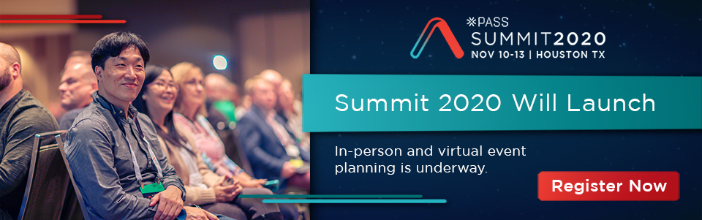
We are covering all bases to ensure our community can continue reaching new and exciting heights. Plans are underway for the in-person event you all know and love along with a new venture, a new opportunity: a PASS Summit 2020 Virtual Event.
Find out more at PASS.org/summit

Slide 5





Thank you to our Global Sponsors and Supporters

Slide 6
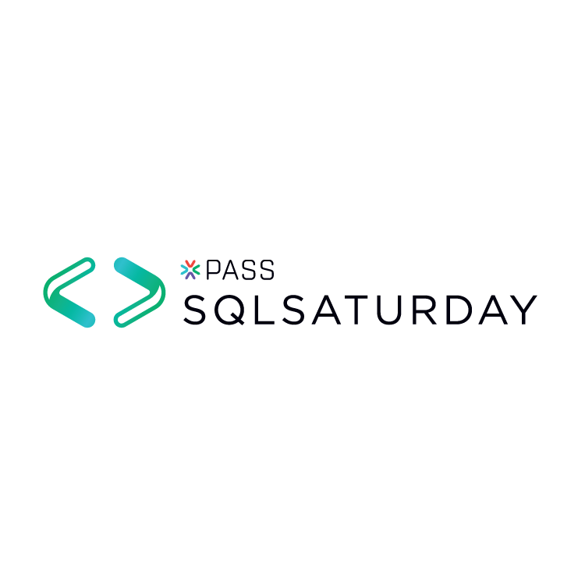







Thank you to our Local Sponsors and Supporters

Slide 7
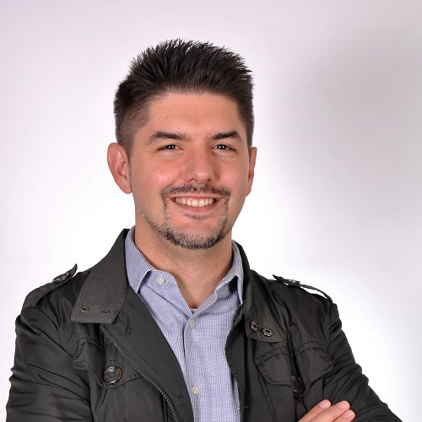
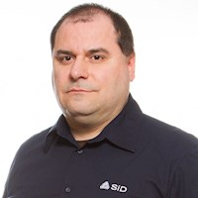
About Us
Alessandro Alpi
Giuliano Latini
suxstellino
giulianolatini
@suxstellino
@giulianolatini
suxstellino
giulianolatini

Slide 8
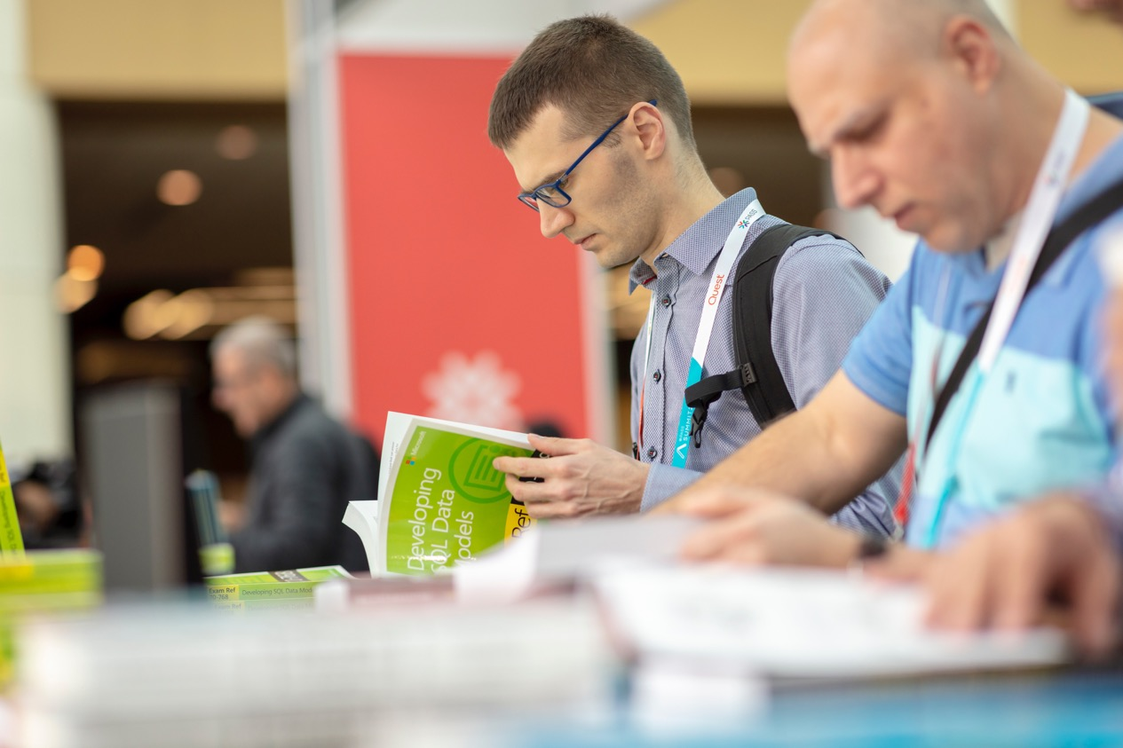
For a long time we had to face…

Slide 9
Three tricky problems
Debug our apps on production data (also for edge cases)
Execute perf and integration tests on production databases
Review the deployment script for preventing regressions

Slide 10
Three tricky problems
Debug our apps on production data (also for edge cases)
Execute perf and integration tests on production databases
Review the deployment script for preventing regressions

Slide 11
Everything leads to…

Slide 12
…provision production data
Get real production data in a couple of minutes
Automate the process of data generation
Use data in a non-production environment

Slide 13
With this requirements
Real, obfuscated sensitive data
Isolated, repeated tests
Short feedback cycle

Slide 14
Approaches

Slide 15
Classic approaches
Restore production databases
Bulk Load via ETLs or SQL Scripts
Copy cross servers via SQL Scripts

Slide 16
Modern approaches
Native clones (DBCC CLONEDATABASE)
Virtual clones (SQL Clone by Redgate)
Containers (Docker)
[SPOILER ALERT] Both Containers and Clones ☺

Slide 17
SQL Clone – behind the hood
Source: Data-Image
Full-byte copy of the source database
From backup/live database
Isolated object: Clone
Isolated copy of the database
Created in less than 30sec
Each data-image can generate many clones

Slide 18
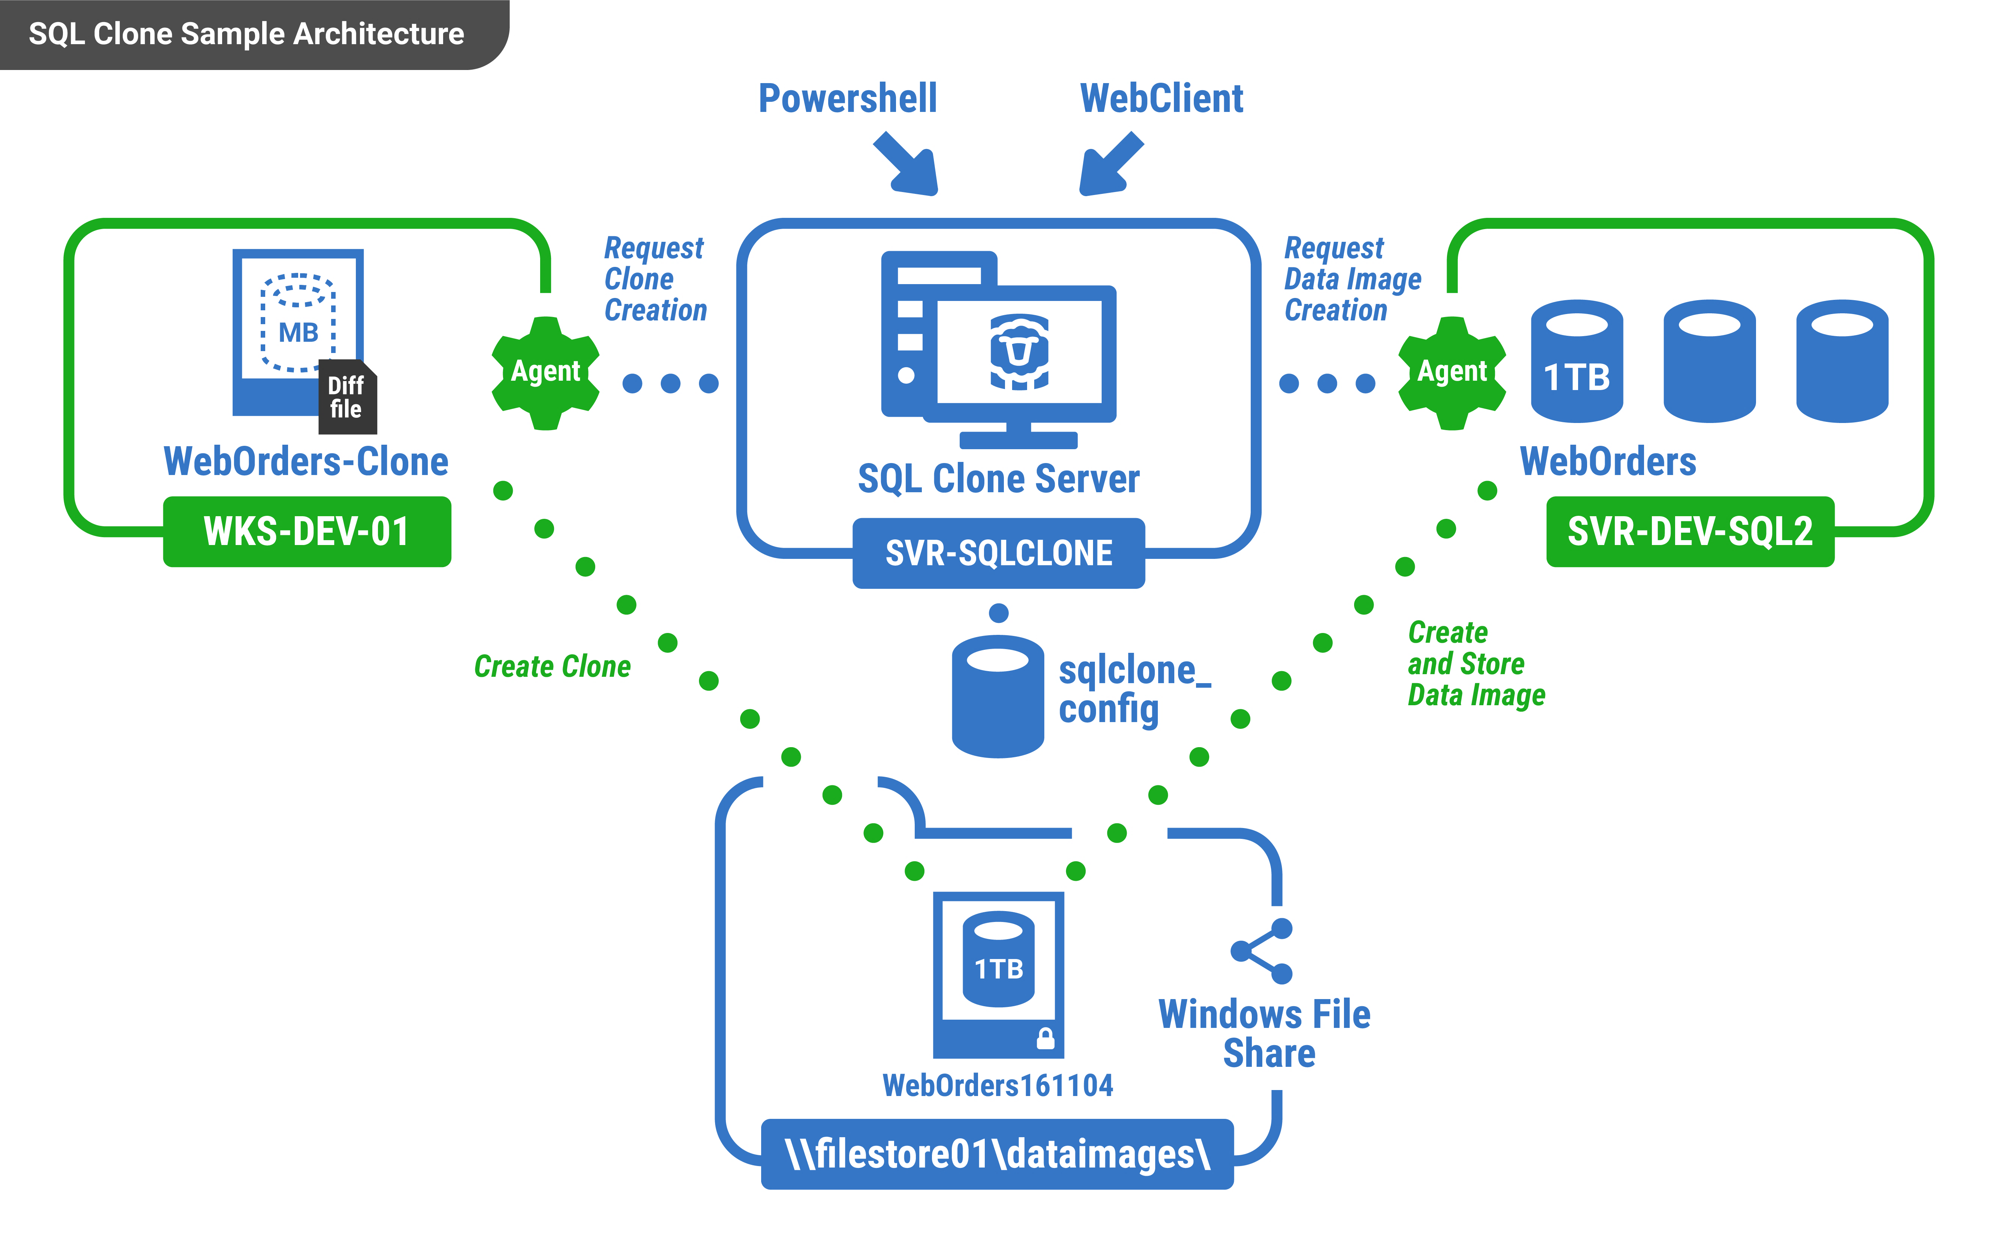
SQL Clone – architecture

Slide 19


SQL WARS
DEMO – SQL Clone

Slide 20
Containers
SQL engine with less footprint
running on multiOS environment
high and quickly consolidation
Infrastructure as Code
On Premises or in cloud it’s the same
Isolated object to access data
COW fs features have zero costs to resolve write collision
multiple engine access same data using clones of data volumes
writing and persistence isolations with fast snapshot of volume

Slide 21
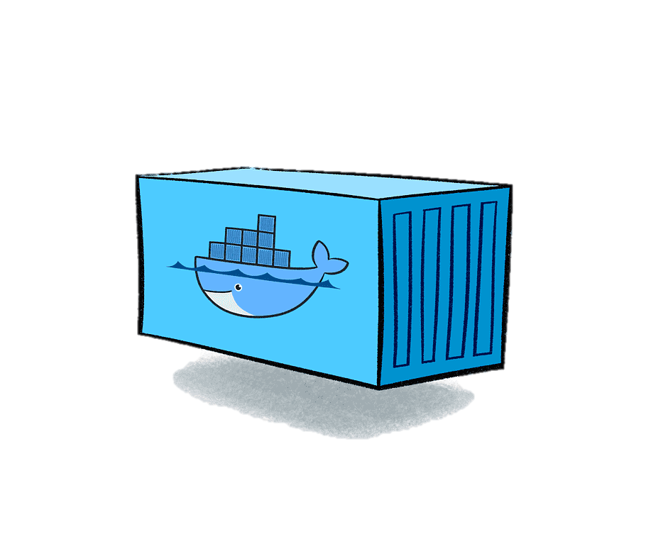
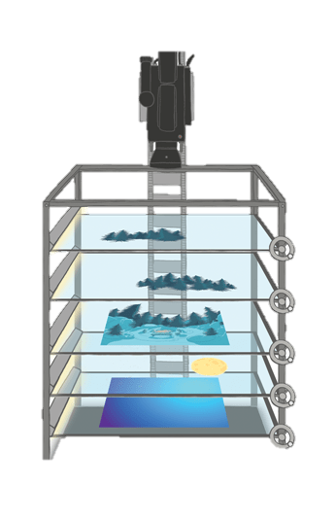

Containers
TIME
SQLPROD
SQLTEST
SQLTEST

Slide 22

Docker solution
SQL TESTSUITE1
docker run -d \
-v dbtest:/data sql
SQL PRODUCTION
docker run -d \
–v dbprod:/data sql
buttervolume clone dbprod dbtest

Slide 23
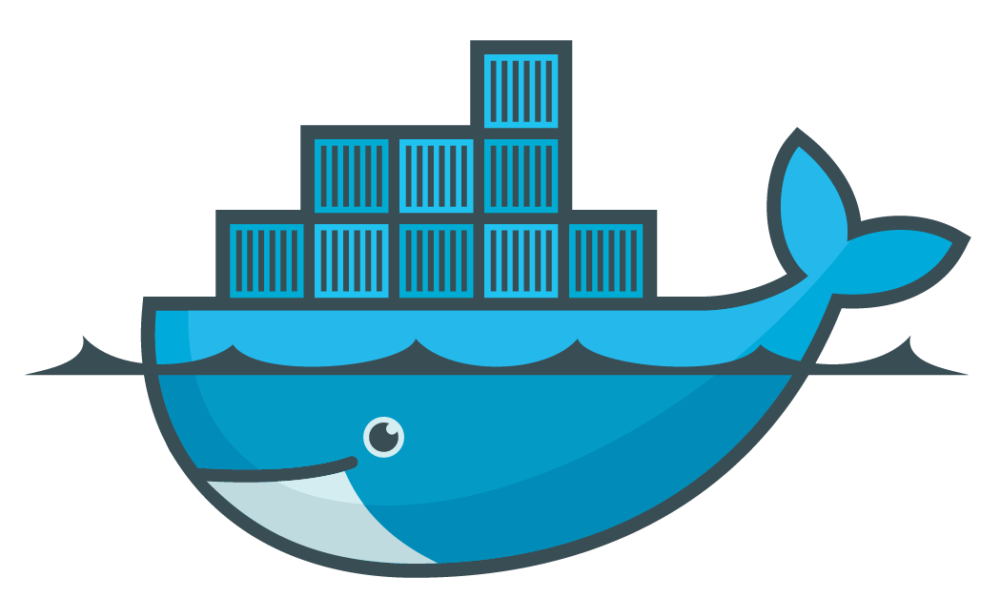
SQL WARS
DEMO – SQL Server with Containers

Slide 24
Both will resolve tricky problems

Slide 25
SQL Clones vs Containers
Container
Quick, isolation
Cross platform
Production must be «containerized»
SQL Clone
Quick, isolation
Only Windows
Perfect for classic VMs (no container)

Slide 26
Resources
DBCC CLONEDATABASE:
https://docs.microsoft.com/en-us/sql/t-sql/database-console-commands/dbcc-clonedatabase-transact-sql?view=sql-server-ver15
SQL Clone:
https://www.red-gate.com/products/dba/sql-clone/
Docker for SQL Server:
https://docs.microsoft.com/en-us/sql/linux/quickstart-install-connect-docker?view=sql-server-ver15&pivots=cs1-bash
Docker Hub:
https://hub.docker.com/_/microsoft-mssql-server
Microsoft Container Registry:
https://azure.microsoft.com/en-us/services/container-registry/

Slide 27
Resources
buttervolume:
https://github.com/anybox/buttervolume
Differencing Virtual Hard disk:
https://technet.microsoft.com/en-us/library/cc720381(v=ws.10).aspx
StackOverflow database: https://www.brentozar.com/archive/2015/10/how-to-download-the-stack-overflow-database-via-bittorrent/
SQL Clone on AzureDevOps: https://www.youtube.com/watch?v=fVbmUZ6FhEc

Slide 28

Feedback form: https://speakerscore.com/XJF3
suxstellino
@suxstellino
suxstellino
giulianolatini
@giulianolatini
giulianolatini

